Slide 1
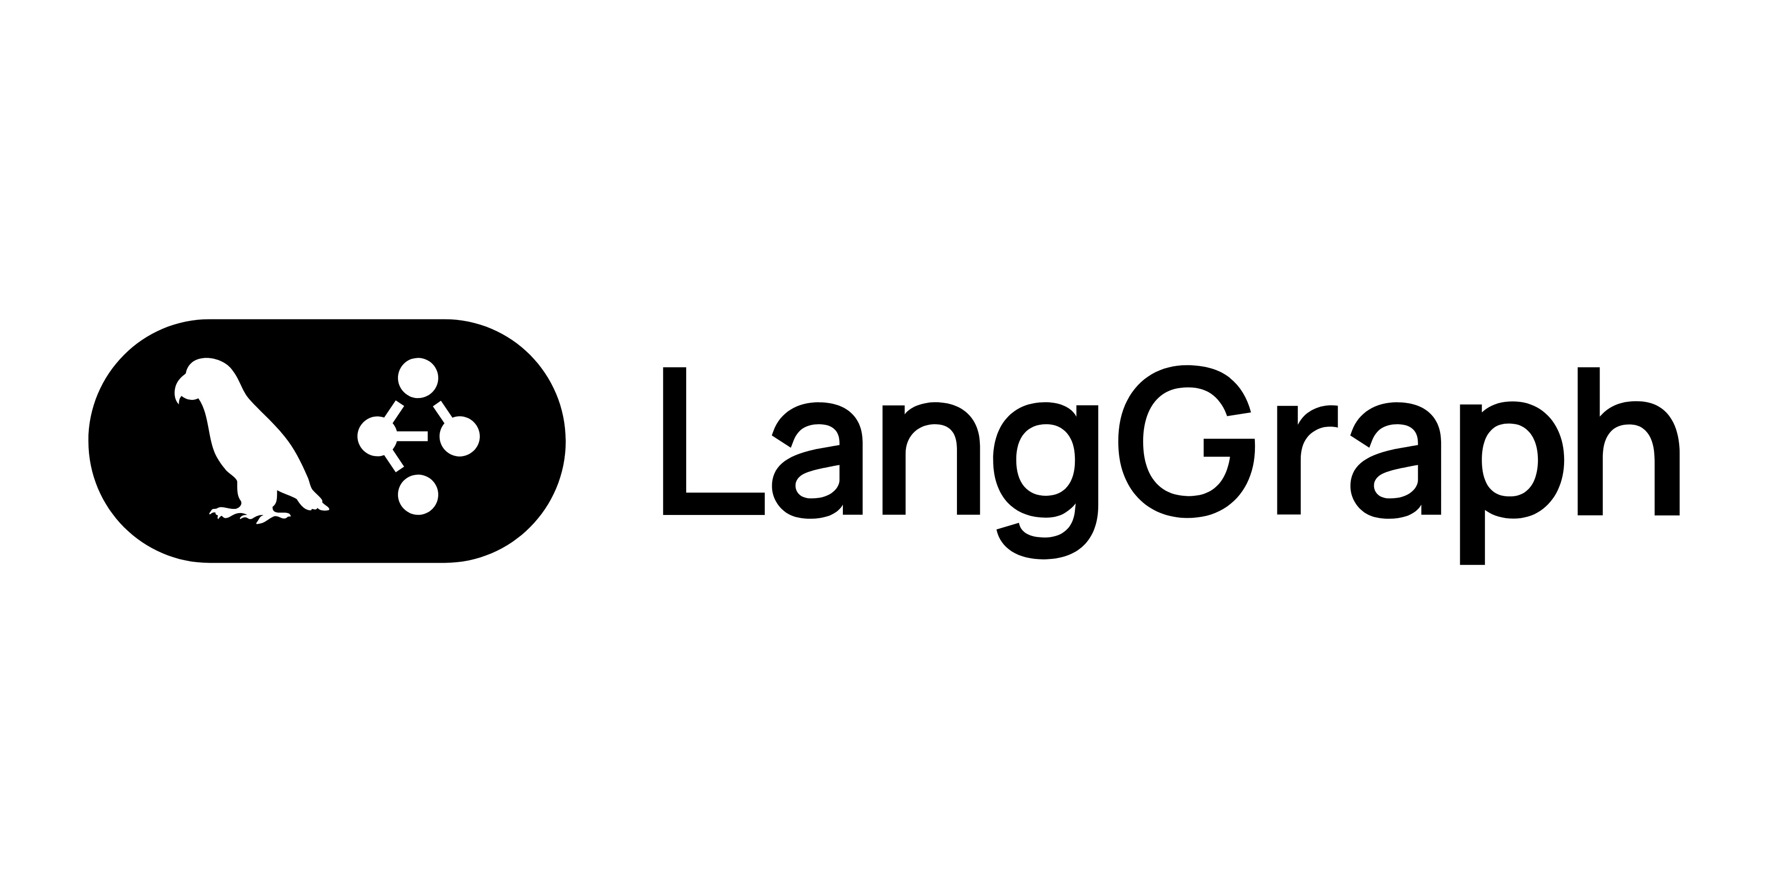
Introduction to LangGraph
Stijn Roscam

Slide 2
https://github.com/roscams/langgraph-introduction-workshop https://bit.ly/4qy63uM https://tundra-thief-3b2.notion.site/API-key-3064578ac6e8808aa271db12f8fe44ed

Slide 3

Who am I?
Stijn Roscam
AI Solution Engineer@Axxes IT Consultancy
Sports enthusiast
Notes:
AI solution engineer: Opzetten van AI oplossingen, binnen Axxes mensen empoweren om AI te gebruiken

Slide 4
Agenda
Introduction and basic graphs
Conditional routing
Tool integration
Persistance & Memory
Multi-Agent orchestration

Slide 5
What is LangGraph?
And when to use it?

Slide 6
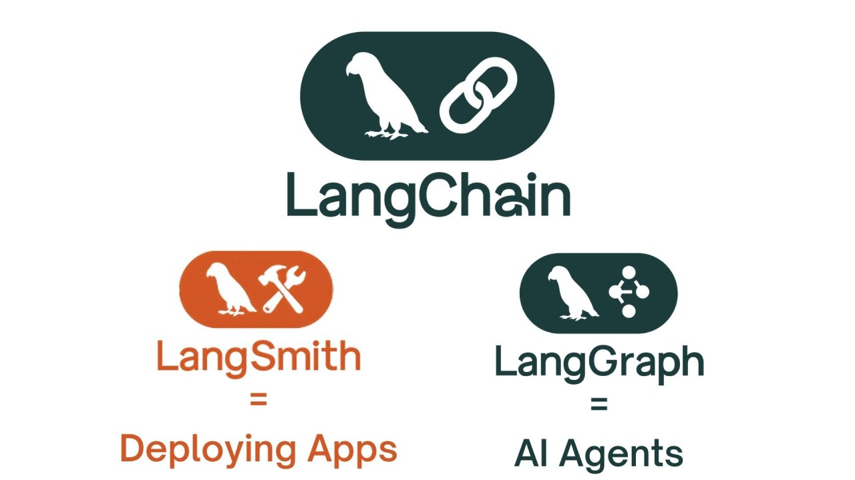
LangGraph overview
Framework for building stateful, multi-actor AI applications
Built on top of LangChain
Graph-based workflow orchestration
First-class support for cycles and loops
Built-in persistence and memory
Human-in-the-loop capabilities

Slide 7
When to use?
Use when
Skip if
Statefull conversations
Complex multi-step workflows
Multiagent collaboration
Human approval workflows
Simple one-shot llm calls
Basic RAG pipelines
No state needed
Linear flows

Slide 8
Core concepts
States, nodes and edges

Slide 9
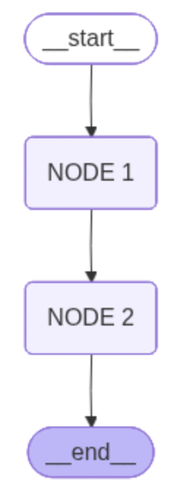
Three building blocks
State
Shared datastructure
Current snapshot of application
“Memory”
Node
Functions that process the state
Take state as input
Return state updates
Edge
Connection between nodes
Direct or conditional

Slide 10
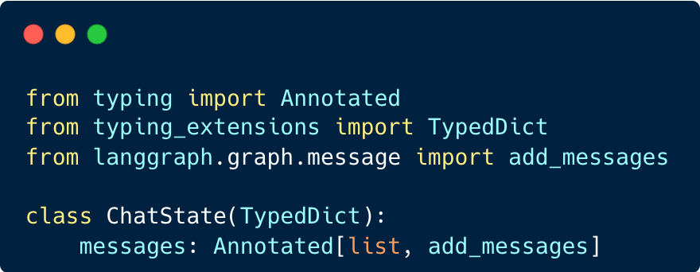
Define state
Shared state across nodes
Use TypedDict or MessagesState
add_messages reducer automatically appends user messages

Slide 11
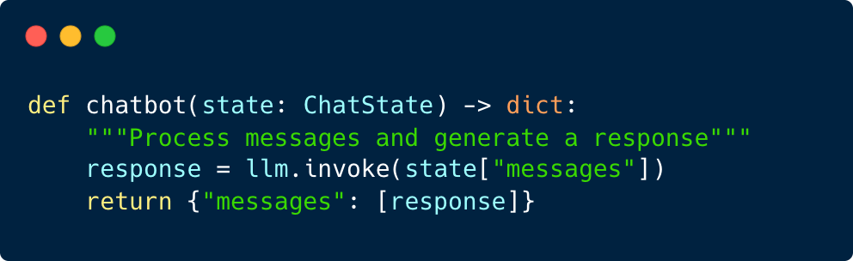
Define node
Python function
Receive current state is input
Return dict with state updates
Call LLM, API’s, …

Slide 12
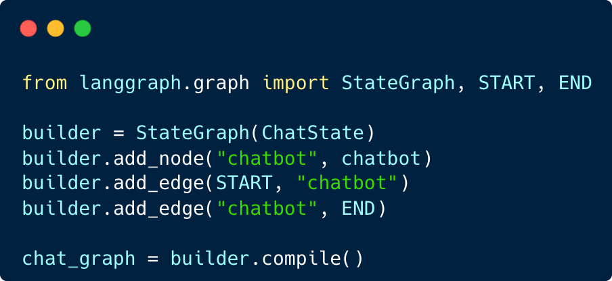
Building the graph
Create StateGraph with state type
Add nodes and edges
Compile to get runnable graph

Slide 13
Conditional Routing
Dynamic flow control

Slide 14
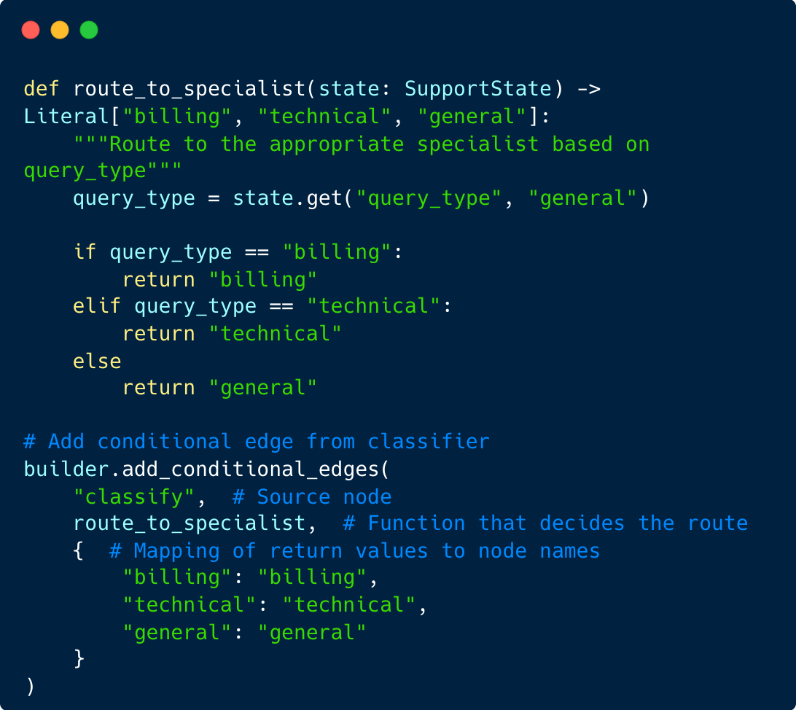
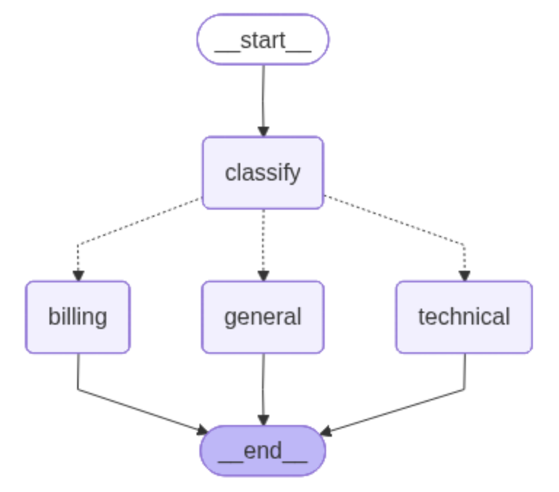
Conditional edges
Create routing decisions based on state
Router function returns next node name

Slide 15
Tool Integration
Extending agent capabilities

Slide 16
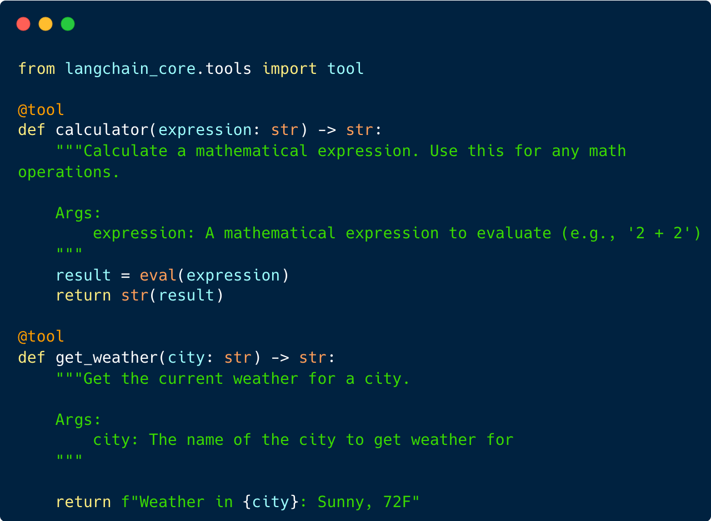
Creating tools
Tools are decorated functions
Docstring becomes tool description
LLM decides when to call certain tool

Slide 17
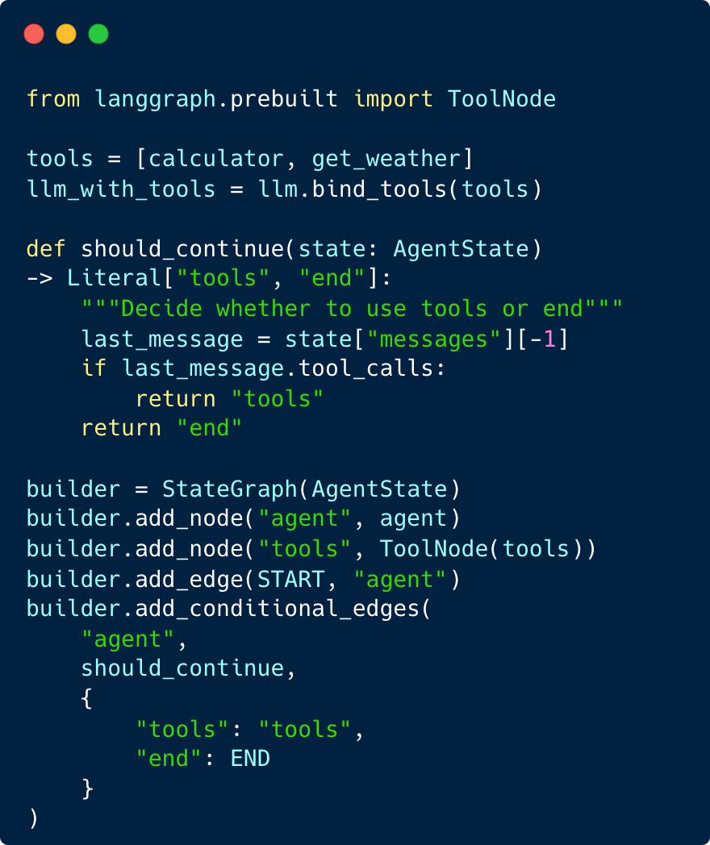
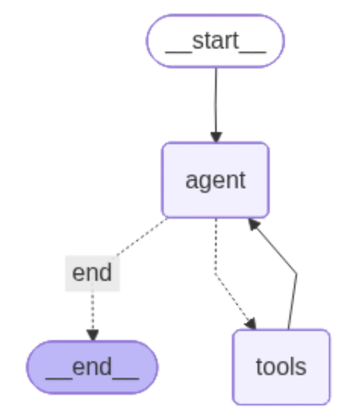
Agent loop pattern
ToolNode executes tools automatically
Add conditional edge
Check for tool calls to route

Slide 18
Persistence & Memory
Multi-turn conversations

Slide 19
Adding memory
Can be in-memory or persistent memory
Track conversations
Checkpointers save state after every node execution
Checkpoints are saved to threads

Slide 20
Multi-Agent Orchestration
Teams of specialized agents

Slide 21

Why multi-agent?
Context window limit - split knowledge
Specialization – different expertise per agent
Parallelism – multiple agents working simultaneously
Modularity – easier to update individual agents
Separation of concerns – cleaner architecture

Slide 22
Supervisor
1 supervisor node that delegates work to other “worker-nodes”
Worker nodes report back to supervisor node
Supervisor decides to route to other workers or to finish

Slide 23
Swarm/handoff
No supervisor
Every node can handoff work to every other node
Every node can end a task
Default node to start the work

Slide 24
Summary
Key takeaways

Slide 25
What we learned
1. Core Concepts: State, Nodes, Edges
2. Conditional Routing: Dynamic flow control
3. Tool Integration: Extend agent capabilities
4. Persistence: Multi-turn conversations
5. Multi-Agent: Supervisor and Swarm patterns
6. Prebuilt Components: Production shortcuts

